Slide 1

Customer Data Analysis

Slide 2

PROJECT TITLE : PRDA-05 Customer Data Analysis
PROJECT ID : PTID-CDA-DEC-25-971
TEAM MEMBERS:
JEYASIMA.C
DIVAGAR.J
HARISH.V
Notes:
2

Slide 3

OBJECTIVE :
“The objective of this project is to analyze customer shopping behavior across gender, age groups, product categories, and payment methods using Power BI in order to identify sales patterns, revenue contribution, and actionable business insights.”

Slide 4
ABOUT DATASET :
This dataset contains shopping information from 10 different shopping malls between 2021 and 2023.
We have gathered data from various age groups and genders to provide a comprehensive view of shopping habits in Istanbul.
The dataset includes essential information such as invoice numbers, customer IDs, age, gender, payment methods, product categories, quantity, price, order dates, and shopping mall locations.

Slide 5
Attribute Information
Invoice_no :
A combination of the letter 'I’
and a 6-digit integer uniquely
assigned to each operation
Quantity :
The quantities of each product (item) per transaction.
Price :
Product price per unit in Turkish Liras (TL).
Customer_id :
A combination of the letter 'C' and a 6-digit integer uniquely assigned to each operation.
Payment_ method :
String variable of the payment method (cash, credit card, or debit card) used for transaction.
Gender :
String variable of the customer's gender.
Invoice_date :
The day when a transaction was generated.
Age :
Positive Integer variable of the customer's age
Shopping_Mall :
String variable of the name of the shopping mall where the transaction was made.
Category :
String variable of the category of the purchased product.

Slide 6
Tasks :
Analyzing Shopping Distribution
• Task 1 : Shopping distribution according to gender: How is the shopping distribution according to gender?
• Task 2 : Sales comparison by gender: Which gender did we sell more products to?
• Task 3 : Revenue generation by gender: Which gender generated more revenue?
• Task 4 : Purchase category distribution: Distribution of purchase categories relative to other columns?
Age Group Analysis
• Task 5 : Shopping distribution by age: How is the shopping distribution according to age?
• Task 6 : Sales comparison by age category: Which age category did we sell more products to?
• Task7 : Revenue generation by age category: Which age category generated more revenue?
• Task 8 : Purchase category distribution: Distribution of purchase categories relative to other columns?
Payment Method Analysis
• Task 9: Relationship with other columns: Does the payment method have a relation with other columns?
• Task 10 : Payment method distribution: How is the distribution of the payment method?

Slide 7
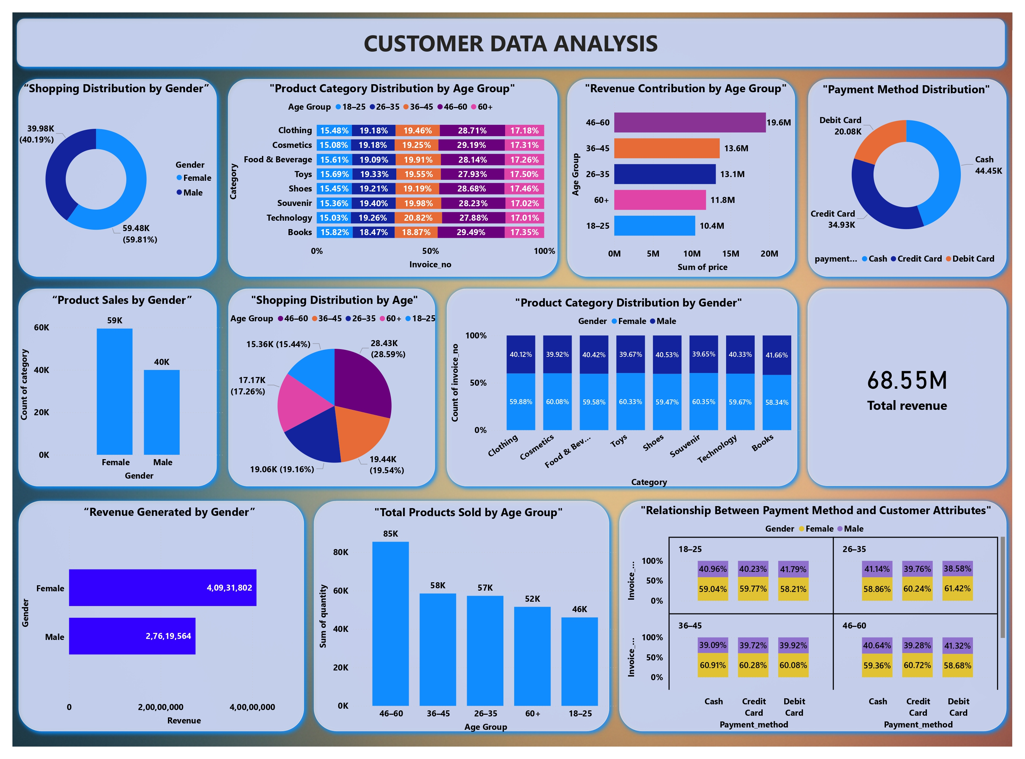
Dashboard:

Slide 8
DERIVED INSIGHTS :
Task 1: How is the shopping distribution according to gender?
Shopping distribution shows that female customers dominate overall shopping activity :
Female: ~59.8%
Male: ~40.2%
This indicates that female customers make a higher number of purchases compared to male customers.
Task 2: Which gender did we sell more products to?
The company sold more products to female customers.
Female product count is significantly higher than male.
This suggests stronger product demand and higher purchase frequency among female customers.
Task 3: Which gender generated more revenue?
Female customers generated more revenue than male customers :
Female revenue ≈ ₹4.09 Cr
Male revenue ≈ ₹2.76 Cr
This shows that female customers not only buy more products but also contribute higher overall revenue.

Slide 9
DERIVED INSIGHTS :
Task 4: Distribution of purchase categories relative to age group
Product category preference varies across age groups:
46–60 age group contributes the highest share across most categories.
Categories like Clothing, Cosmetics, and Books are popular across all
age groups.
Younger groups (18–25, 26–35) show balanced interest across
categories, while middle-aged groups spend more consistently.
Task 5: How is the shopping distribution according to age?
Shopping distribution by age shows:
46–60 age group has the highest shopping share.
Followed by 36–45 and 26–35.
18–25 has the lowest shopping contribution.
This indicates that middle-aged customers are the most active shoppers.
Task 6: Which age category did we sell more products to?
The 46–60 age group purchased the highest number of products (~85K units).
This age group forms the core customer base in terms of quantity sold.

Slide 10
DERIVED INSIGHTS :
Task 7: Which age category generated more revenue?
The 46–60 age group generated the highest revenue (~₹19.6M).
They are followed by:
36–45
26–35
This indicates higher purchasing power and consistent spending in the 46–60 segment.
Task 8: Distribution of purchase categories relative to gender
Product category distribution shows:
Female customers dominate most categories, contributing ~58–60%.
Male contribution remains consistent at ~40%.
This indicates strong female preference across categories such as
Clothing, Cosmetics, and Books.

Slide 11
DERIVED INSIGHTS :
Task 9: Does the payment method have a relation with other columns?
Yes, payment method shows a clear relationship with age and gender.
Cash is more popular among older age groups.
Credit and Debit cards are more preferred by younger and middle-aged customers.
Female customers show slightly higher digital payment usage than males.
This confirms that payment behavior varies by demographic group.
Task 10: How is the distribution of the payment method?
Payment method distribution shows:
Cash is the most used payment method.
Followed by Credit Card, then Debit Card.
Despite digital growth, cash remains dominant among customers.

Slide 12
SUGGESTIONS :
Task 1: Shopping Distribution by Gender
📌 Suggestion:
Since female customers contribute the majority of shopping activity, the company should:
  Launch female-focused marketing campaigns
  Introduce women-centric loyalty programs
  Create offers to encourage higher engagement from male customers.
Task 2: Product Sales by Gender
📌 Suggestion:
  Increase inventory for products preferred by female customers.
  Design bundle offers and discounts to boost product sales among male customers
  Use personalized recommendations based on gender preferences
Task 3: Revenue Generated by Gender
📌 Suggestion:
  Promote premium and high-margin products to female customers.
  Apply upselling and cross-selling strategies for male customers to improve revenue.
  Introduce exclusive offers for high-spending customer segments.

Slide 13
SUGGESTIONS :
Task 4: Product Category Distribution by Age Group
📌 Suggestion:
Customize product placement based on age group preferences.
Stock high-demand categories more for middle-aged customers (46–60).
Create age-specific promotions for underperforming categories.
Task 5: Shopping Distribution by Age Group
📌 Suggestion:
Focus retention strategies (membership, loyalty points) on the 46–60 and 36–45 age groups.
Introduce student or youth discounts to increase shopping from the 18–25 segment.
Task 6: Total Products Sold by Age Group
📌 Suggestion:
Prioritize supply chain planning for age groups purchasing more products.
Offer bulk purchase discounts for the most active age groups.
Encourage repeat purchases using reward programs.

Slide 14
SUGGESTIONS :
Task 7: Revenue Contribution by Age Group
📌 Suggestion:
Promote premium brands and higher-value products to the 46–60 age group.
Introduce EMI or flexible pricing options for other age segments to increase revenue.
Task 8: Product Category Distribution by Gender
📌 Suggestion:
Use gender-based product recommendations on digital platforms.
Position popular female-oriented categories prominently in stores and apps.
Develop targeted ads highlighting category preferences.

Slide 15
SUGGESTIONS :
Task 9: Relationship Between Payment Method and Customer Attributes
📌 Suggestion:
Encourage digital payments among older customers through cashback offers.
Maintain cash payment options while gradually promoting card usage.
Partner with banks and payment providers for co-branded offers.
Task 10: Distribution of Payment Method
📌 Suggestion:
Improve digital payment infrastructure due to growing card usage.
Offer exclusive discounts for credit/debit card payments.
Continue supporting cash payments to retain traditional customers.

Slide 16

THANK YOU…..

